Slide 1
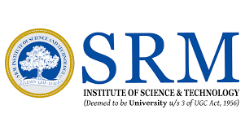
18BTP109L – Major Project
Final Viva Voce
Exploring the Antimicrobial and Antioxidant Activities of Spirulina through In Vitro and In Silico Methods
Name of the Guide:Dr.S.Meena Kumari Student names with registration no:
Designation :Assistant Professor Naga Pavan Sai J - RA2111009010265
Sriram B - RA2111009010253
Fawaz - RA2111036010025
Sherin - RA2111009010143
Department of Biotechnology
School of Bioengineering
SRM Institute of Science and Technology
Kattankulathur

Slide 2
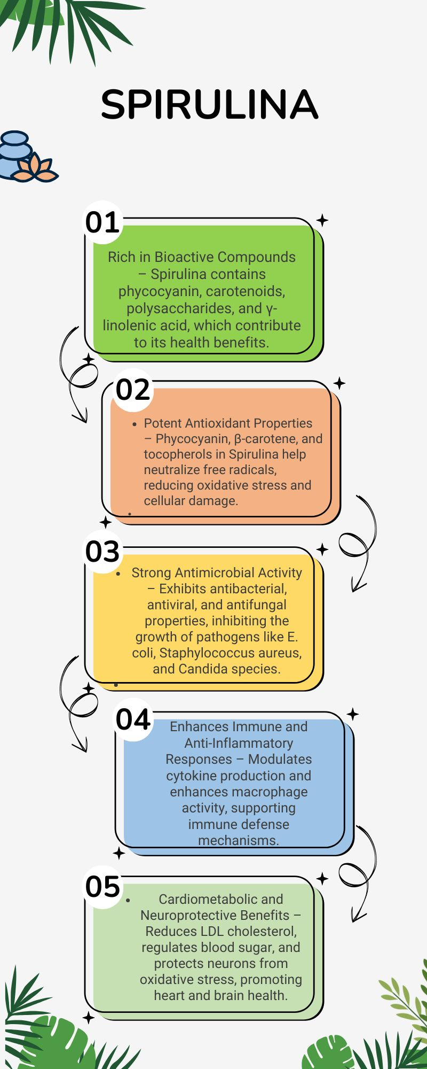
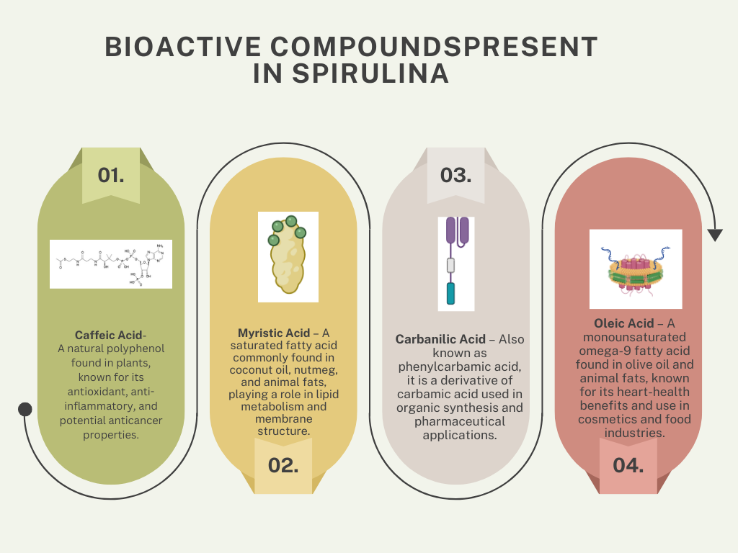
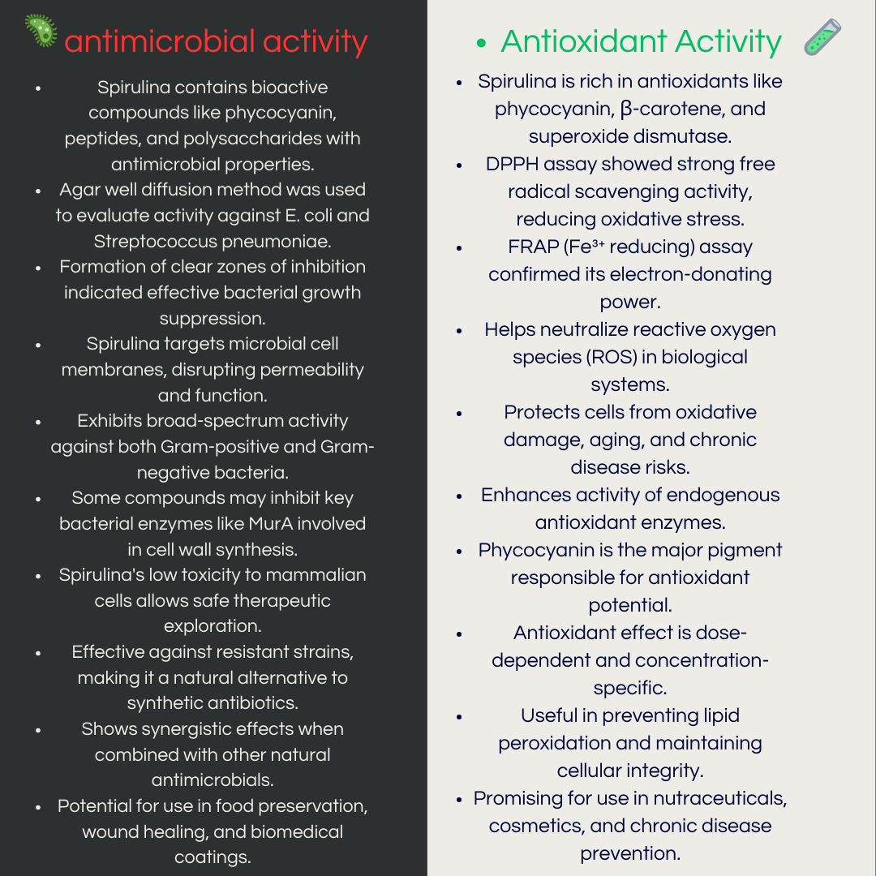
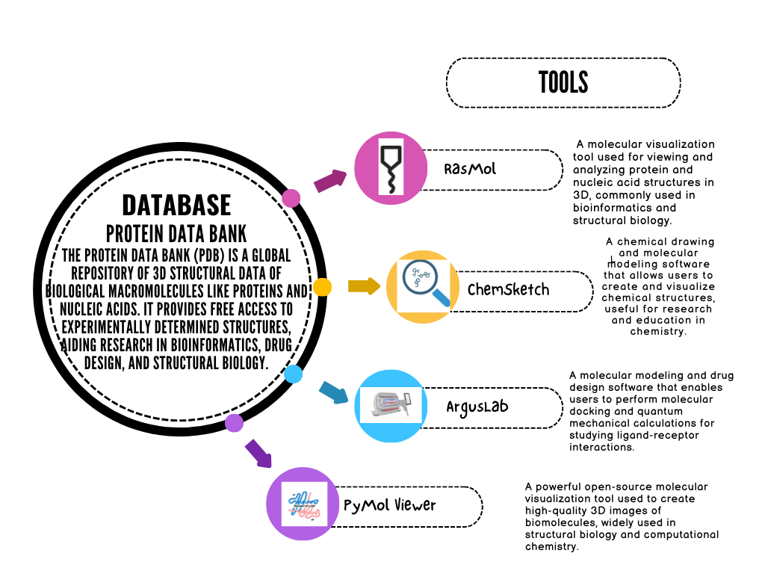
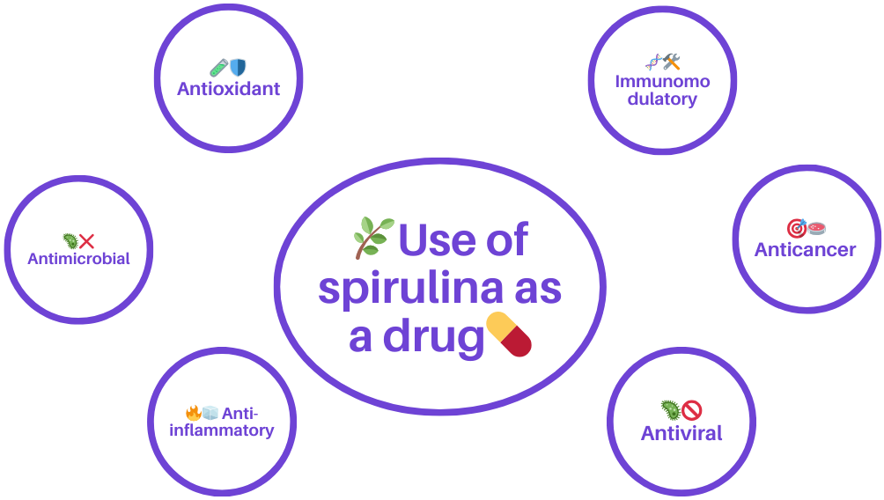
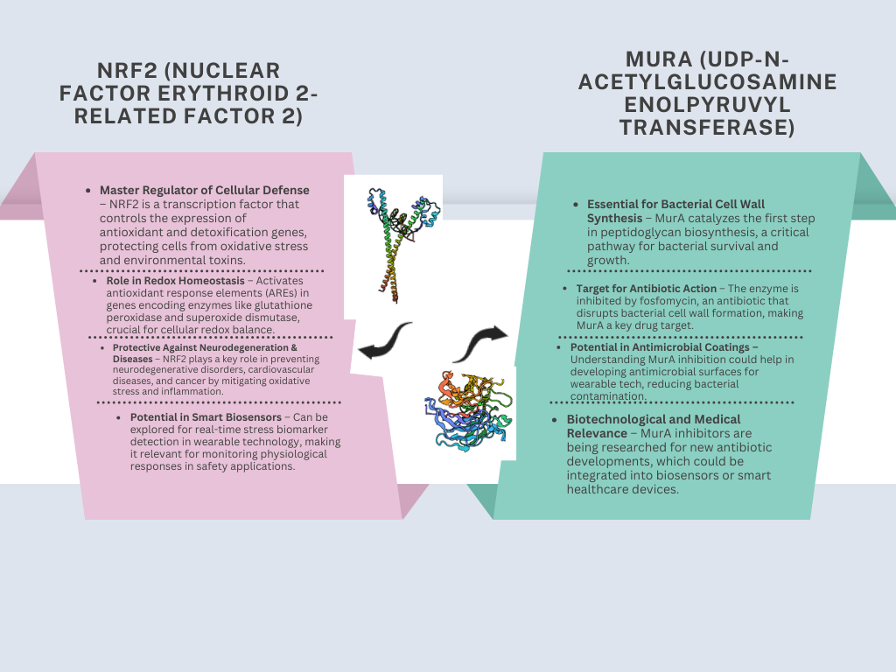
INTRODUCTION

Slide 3
HYPOTHESIS
This research hypothesizes that Spirulina platensis possesses notable antimicrobial and antioxidant properties because of its rich composition of bioactive compounds which are explored through in vitro and in silico methods.
OBJECTIVE(S)
To extract bioactive compounds from Spirulina using ethanol as a solvent.
To characterize the ethanol extract of Spirulina using analytical techniques.
To evaluate the antimicrobial and antioxidant activities of the Spirulina extract.
To perform in silico molecular docking of Spirulina compounds with Nrf2 and MurA proteins.

Slide 4
LITERATURE REVIEW
S.No | Description | Author/Journal
1. | In vitro analysis of Spirulina extract revealed significant zones of inhibition against pathogenic bacteria like E. coli and Streptococcus mutans . | Khan, Z. et al., [2005]
2. | Antioxidant potential of Spirulina was confirmed through DPPH and Fe³⁺ reduction assays, highlighting its radical scavenging ability. | Miranda, M. S. et al., [1998]
3. | In silico docking of Spirulina-derived peptides showed strong interactions with microbial target proteins like MurA, supporting antimicrobial potential. | Sharma, N. et al., [2020]
4. | Spirulina exhibited cytoprotective effects and low toxicity in in vitro MTT assays on 3T3 fibroblast cells. | Belay, A. et al., [2002]
5. | Computational and molecular docking studies revealed phycocyanin and phenolic compounds as potential inhibitors of bacterial enzymes. | Mishra, S. K. et al., [2021]
6. | Comprehensive review of in vitro and in silico studies showcasing Spirulina role as a source of natural antimicrobials and antioxidants. | Gershwin, M.E. & Belay, A.,[ 2007]
7. | Study demonstrated the dual antimicrobial and antioxidant effects of Spirulina extracts, with in vitro inhibition of respiratory pathogens and in silico prediction of bioactive compound–protein interactions. | Abdel-Daim, M. M. et al.,[ 2019]

Slide 5
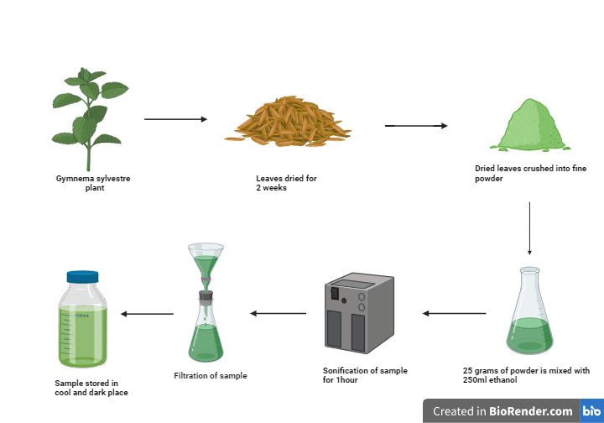
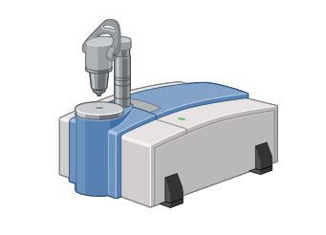
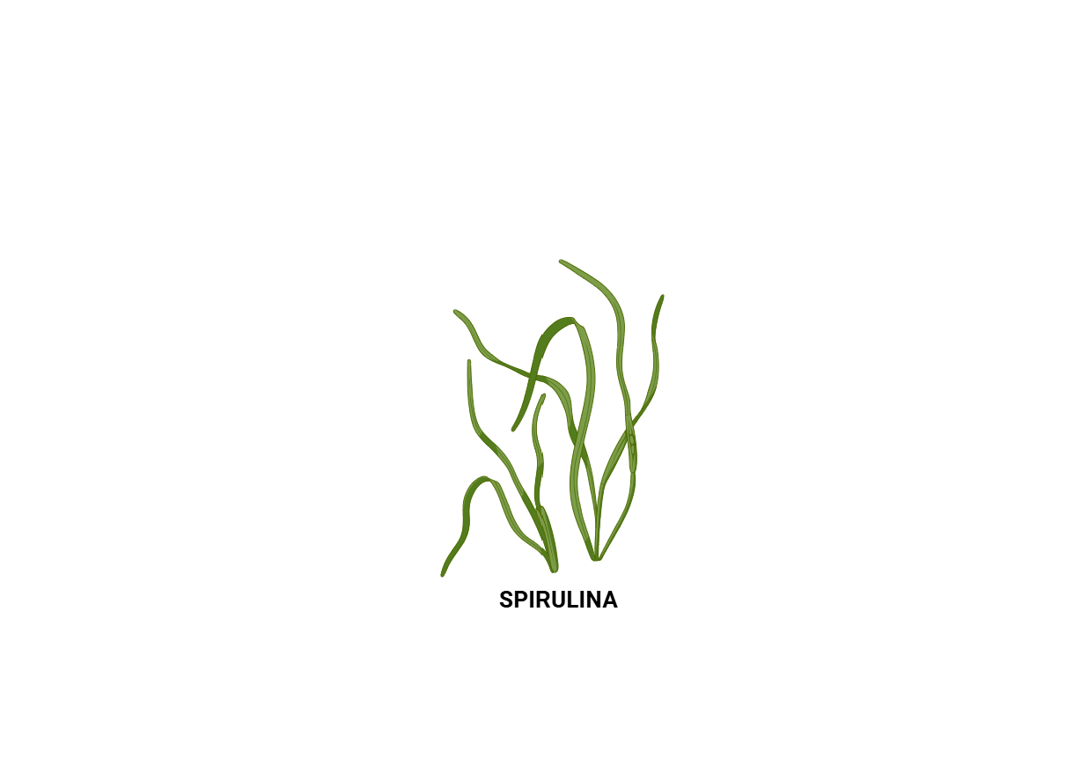
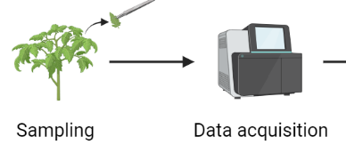
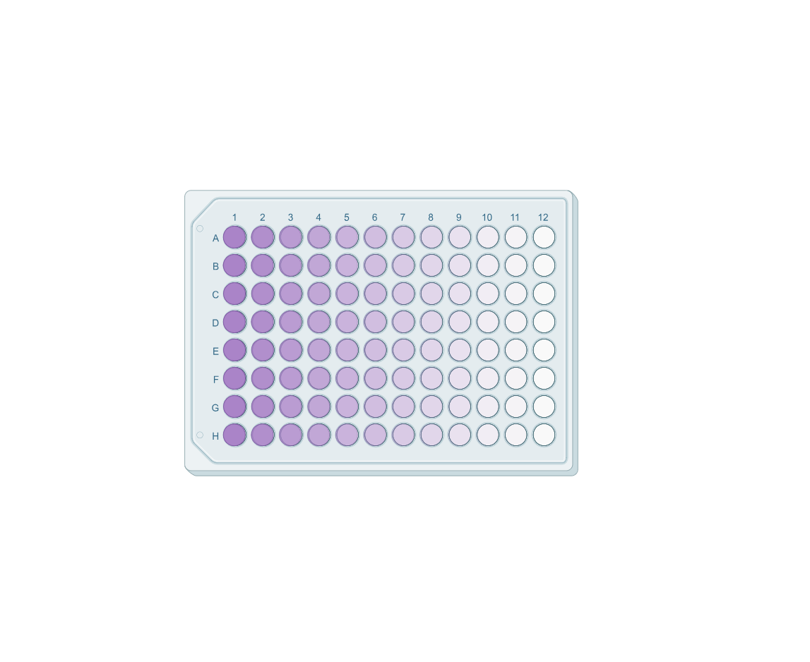
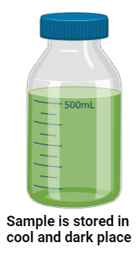
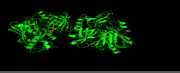
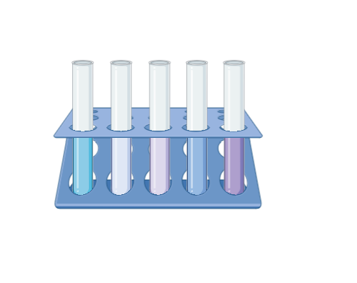
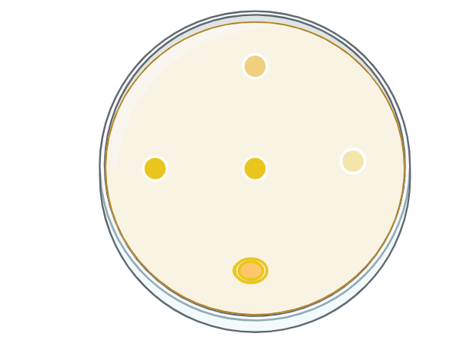
WORKPLAN
Extraction Of Bioactive compounds
Computational Analysis
Characterization ,Antimicrobial And antioxidant activities
Dried sample
Data acquisition through bioinformatics tools
Spirulina biomass
MTT Assay
FTIR SPECTROMETER
Molecular docking visualization of a bioactive compound interacting with a target protein structure.
Extracted sample
25g of sample with 500ml of 70% ethanol
Zone of Inhibition
DPPH & FE3+
Crude extract was obtained through process of UltraSonication from mixture containing ethanol along with the powdered sample
Molecular docking and pathway
analysis, are utilized to predict the molecular mechanisms underlying the antimicrobial and antioxidant .
Bioactive compounds in Spirulina are analysed using FTIR, GCMS and Anti-microbial activity is checked using assays like MTT,Zone of Inhibition and Anti oxidation activity is checked using DPPH and Fe3+

Slide 6
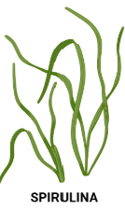
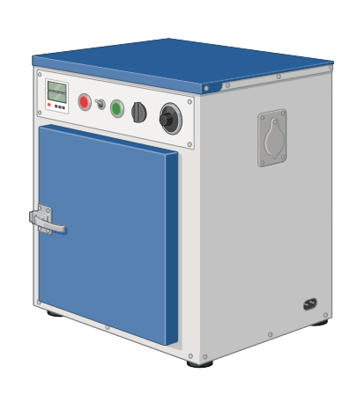
METHODOLOGY
Extraction
Spirulina biomass is collected
The sample was shade-dried
at room temperature
The dried sample was then crushed and made into fine powder
25 g sample powder + 500 ml of 70% Ethanol is mixed [4]
The mixture is then filtered using whatman paper and the resulting mixtures were collected [4]
The resultant mixture is sonicated at 20-40 kHz on 30-40* C for 1.5 hrs with stirring at regular intervals[4].
Sample was placed in hot air oven for drying around 5 hrs at 60 degrees celsius [4]
The mixture is then incubated in a cool,dark place.

Slide 7
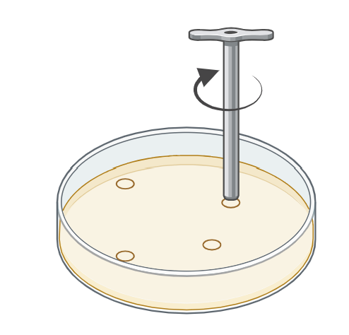
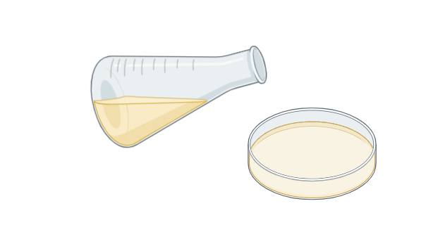
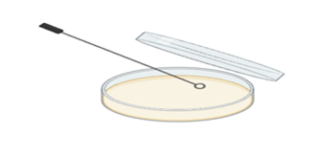
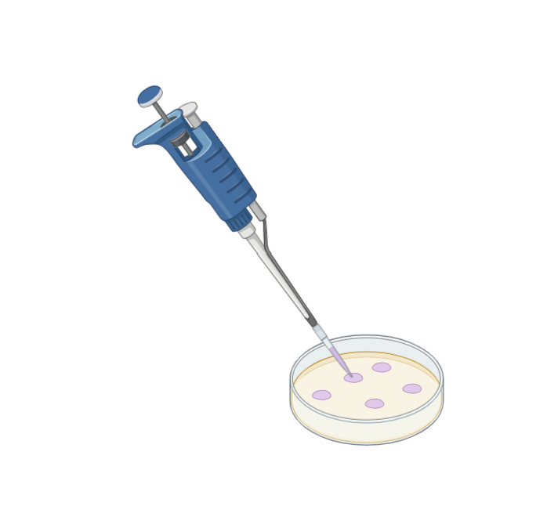
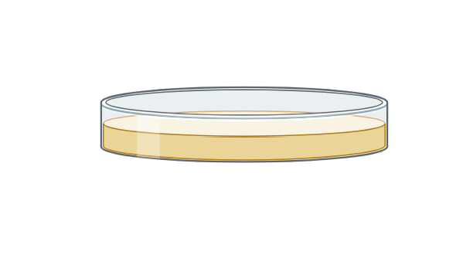
METHODOLOGY
ZONE OF INHIBITION
Nutrient agar was prepared, sterilized, and poured into sterile petri plates
Cultures of Escherichia coli and Streptococcus mutans were evenly spread on the agar surface
Wells were carefully punched into the agar, and the test samples were placed into the wells
Tetracycline (25 µg) was used as a standard antibiotic control
Plates were incubated at 37°C for 24 hours,
The zones of inhibition were measured to evaluate antimicrobial activity.

Slide 8
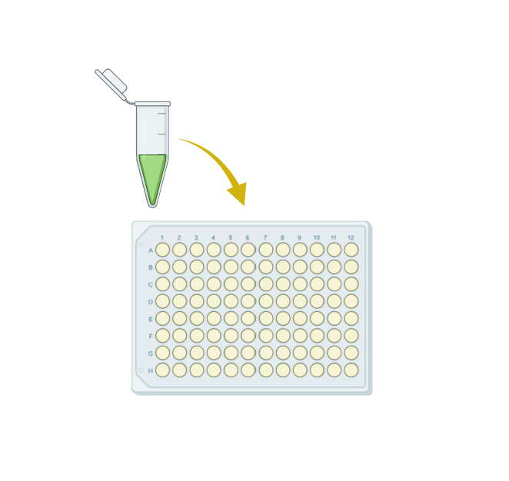
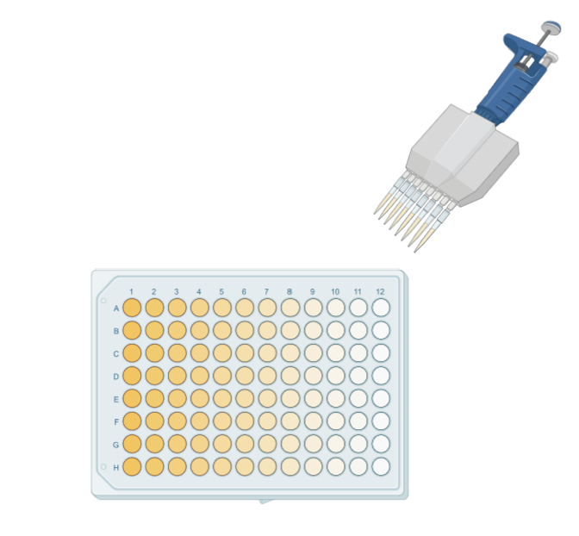
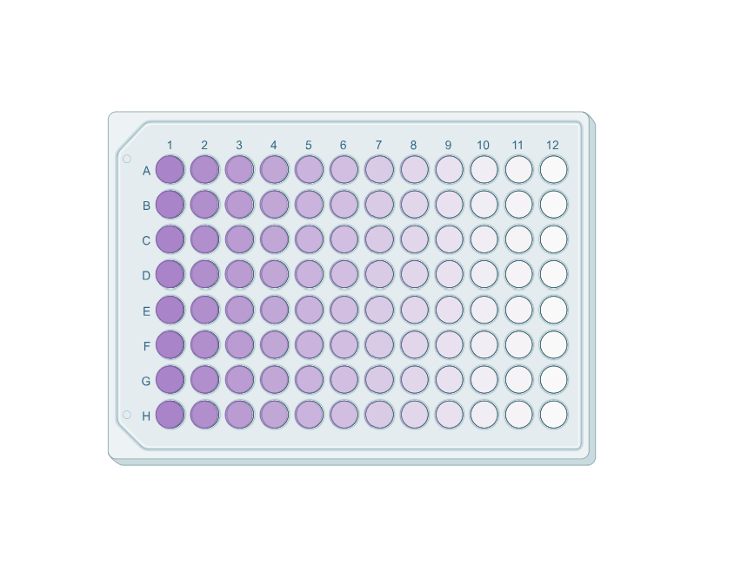
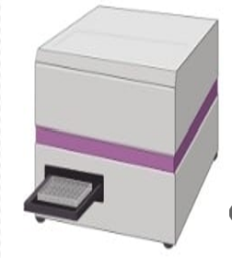
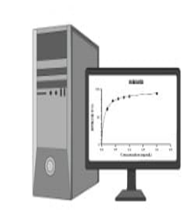
METHODOLOGY
MTT ASSAY OF 3T3 CELLS
Cultured 3T3 Cells were treated with varying concentrations of
the test extracts: 1 ng, 10 ng, 100 ng, and 1 µg.
*48 hrs incubation
MTT reagent (3-(4,5-Dimethylthiazol-2-yl)-2,5-diphenyltetrazolium bromide) was added to each well.
*3 hrs incubation
Formed purple formazan crystals are dissolved on adding DMSO.
The absorbance was measured at 595 nm
Percentage cytotoxicity of the extracts was calculated

Slide 9
METHODOLOGY
1 mL of 0.2 M phosphate buffer (pH 6.6)
1 mL of 1% potassium ferricyanide [K₃Fe(CN)₆].
FERRIC REDUCING POWER ASSAY
DPPH ASSAY
crude extract suspended in varying concentrations (50,100,150,200,250,300 µg/mL ).
A 0.1 mM DPPH solution was prepared in methanol.
crude extract suspended in methanol for varying concentrations (50,100,150,200,250,300 µg/mL ).
1 mL of 0.2 M phosphate buffer and 1 mL of 1% potassium ferricyanide [K₃Fe(CN)₆] are added to extract
1 mL of each extract concentration was mixed with 1 mL of the DPPH solution in test tubes
*30 min incubation
1 mL of 10% trichloroacetic acid (TCA) was added to the mixture.
*45 min incubation
A control was prepared by mixing 1 mL of methanol with 1 mL of DPPH solution (without sample).
1 mL of 0.1% freshly prepared ferric chloride (FeCl₃) solution was added.
The absorbance of the resulting solutions was measured at 517 nm
The absorbance of the resulting solutions was measured at 700 nm

Slide 10
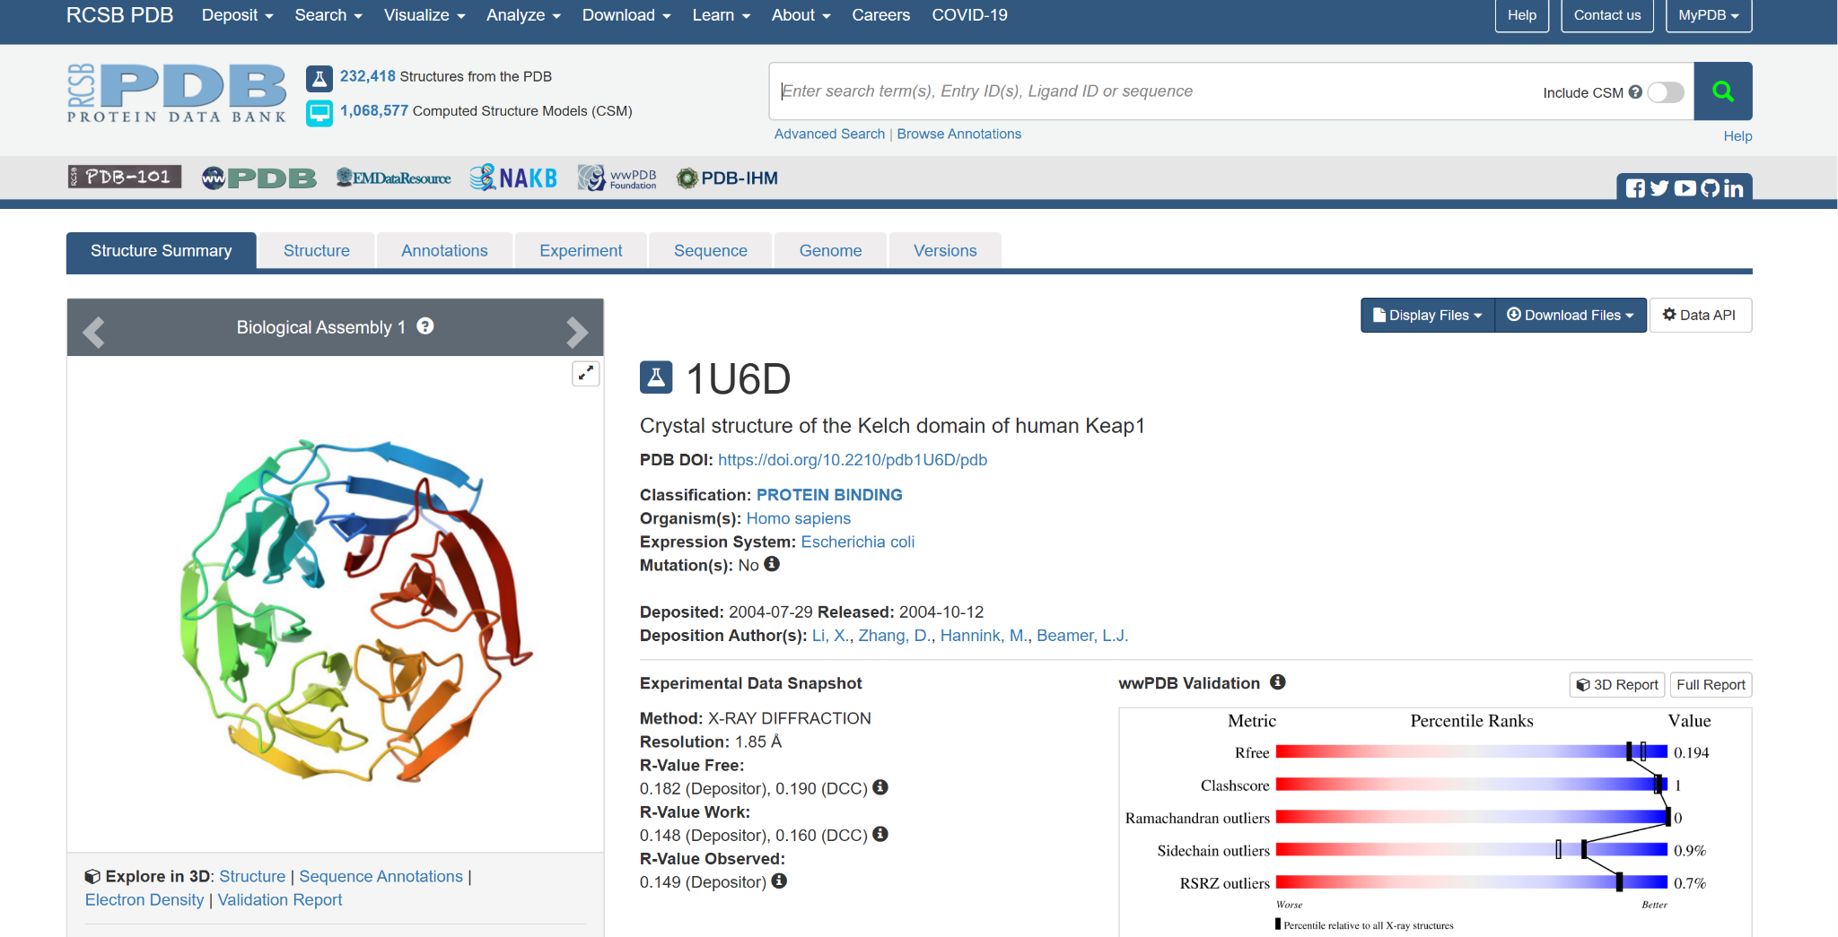
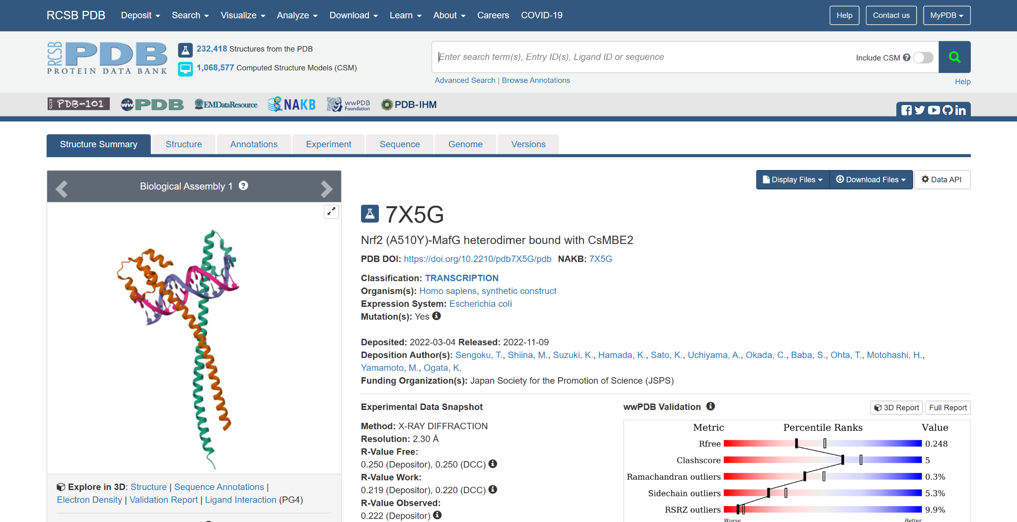
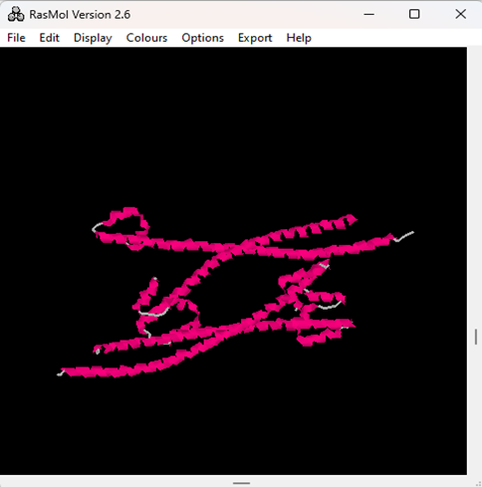
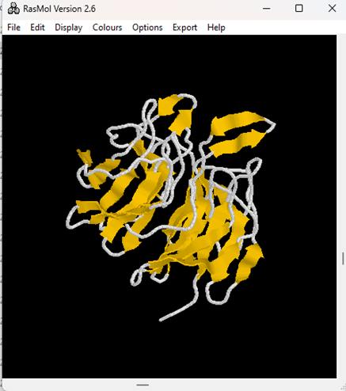
METHODOLOGY:
Selection of Macromolecule (Proteins) responsible for disease -[1]
Nrf2 (PDB ID: 7X5G)
MurA (PDB ID: 1U6D)
Retrieving 3D Structure of protein from PDB Database
Visualisation of proteins structure using Rasmol

Slide 11
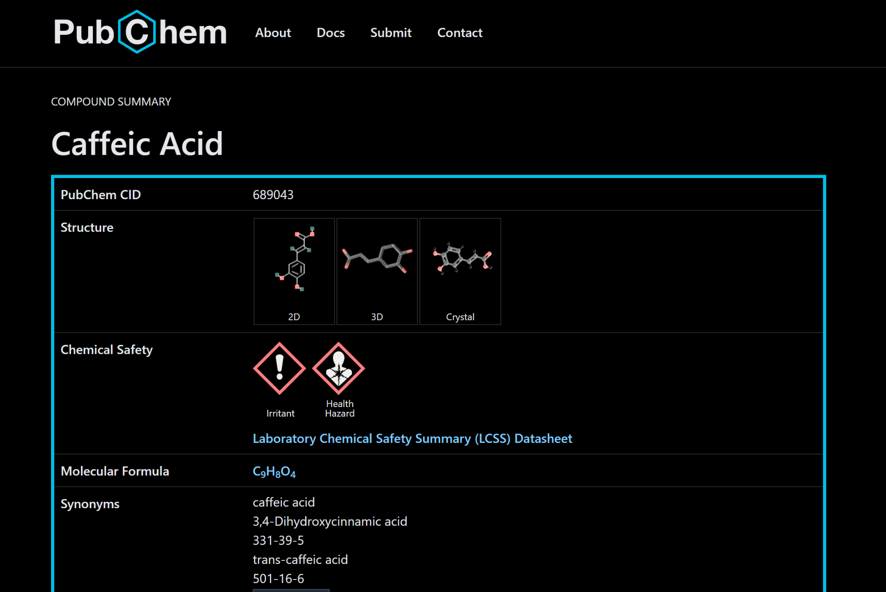
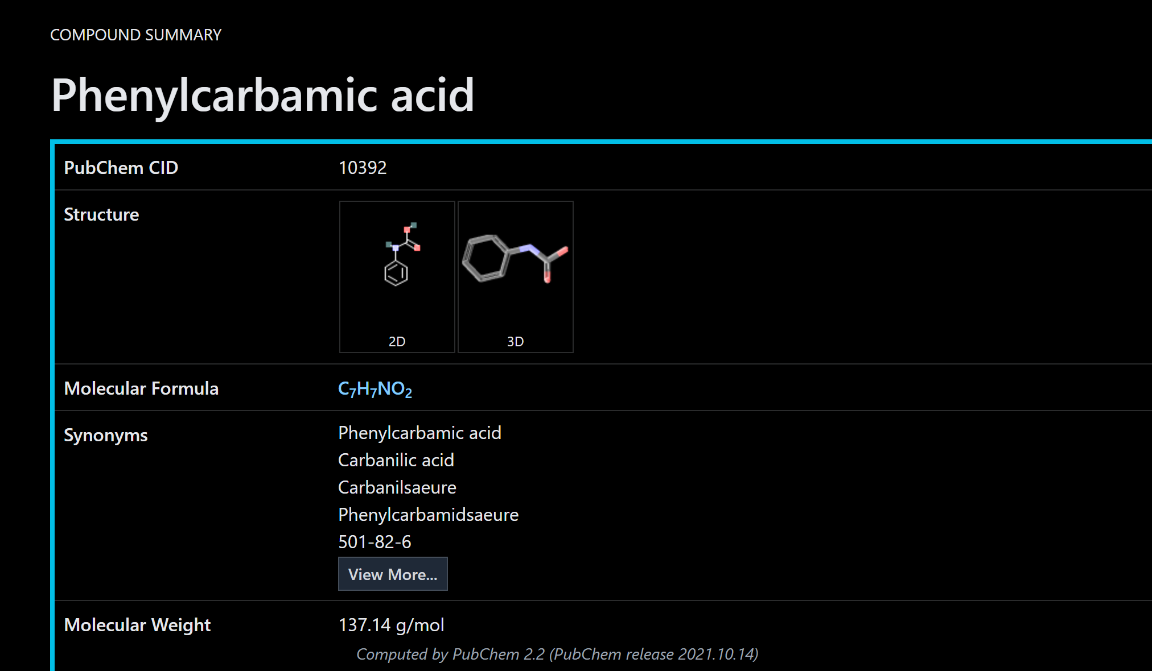
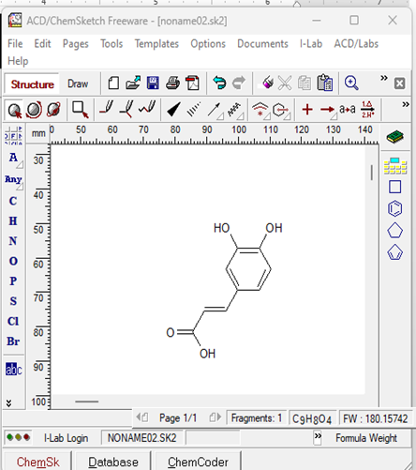
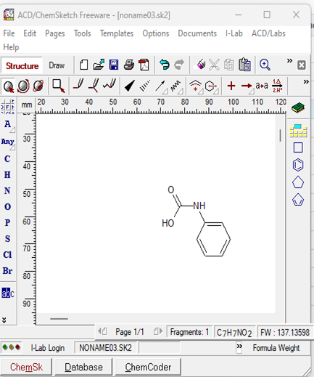
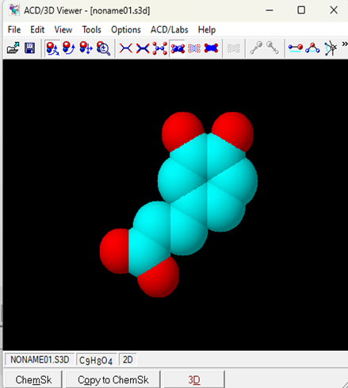
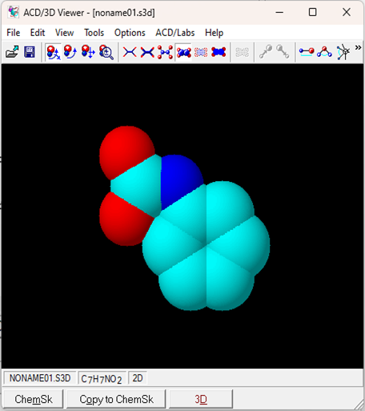
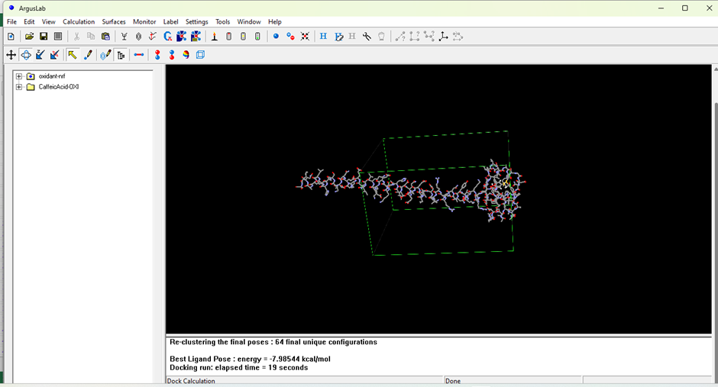
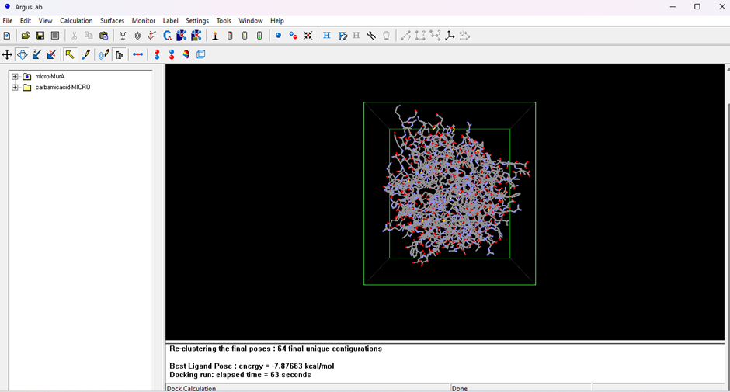
METHODOLOGY
Retrieving Inhibitors from PubChem Database
Drawing the 2D structure of inhibitor in chemsketch
Converting the 2D drawing into 3D structure
Docking (ArgusLab) and Evaluation (PyMol Viewer)

Slide 12

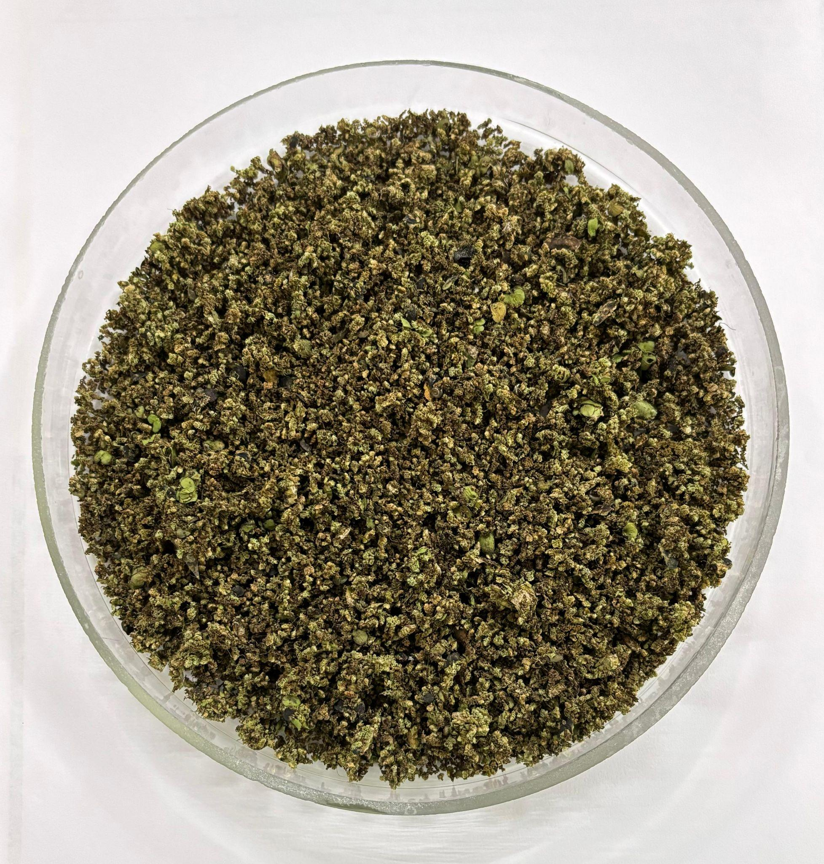
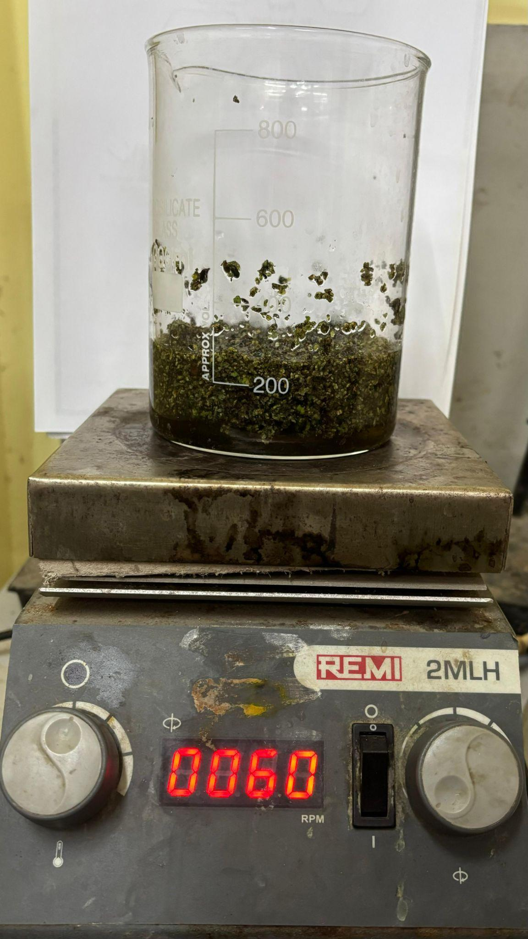

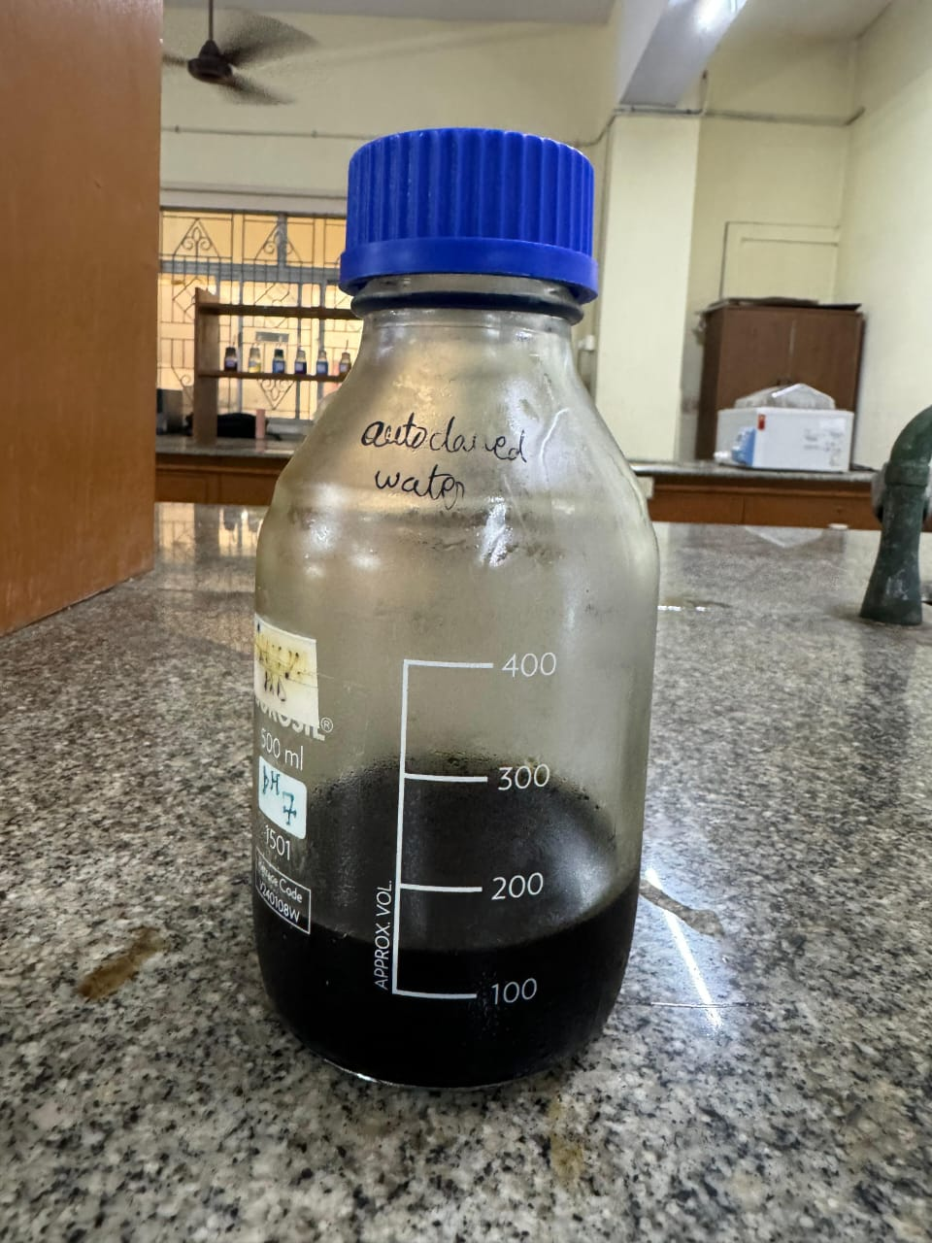
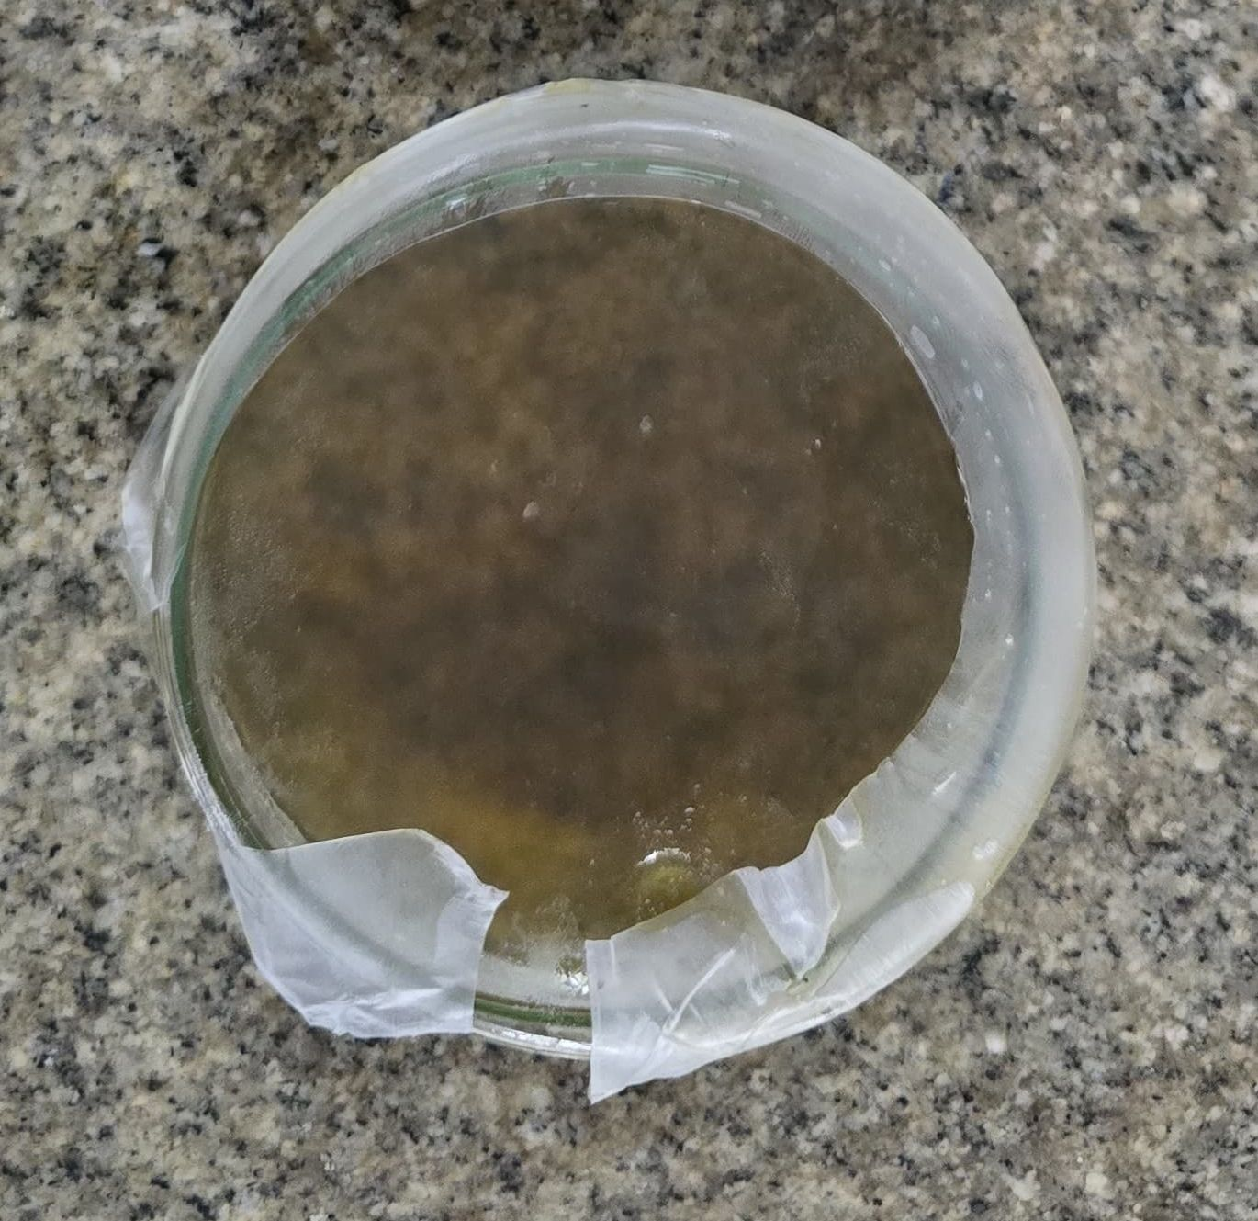
RESULTS
1.Fine powder of Spirulina was obtained through process of drying and crushing
2.The crude extract of the algae was obtained through ultrasonic extraction using ethanol as the solvent and the solvent is further dried for chemical analysis
Ethanol Extract
Dried extract

Slide 13
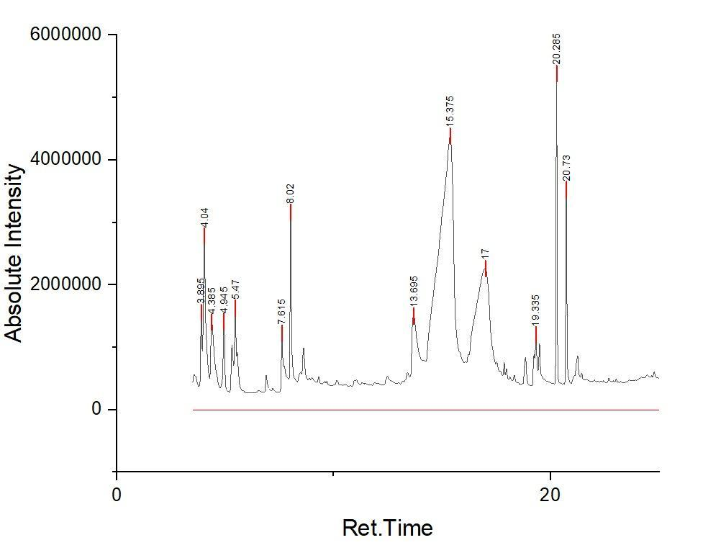
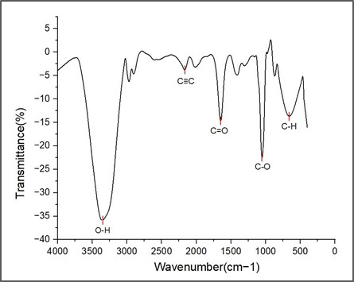
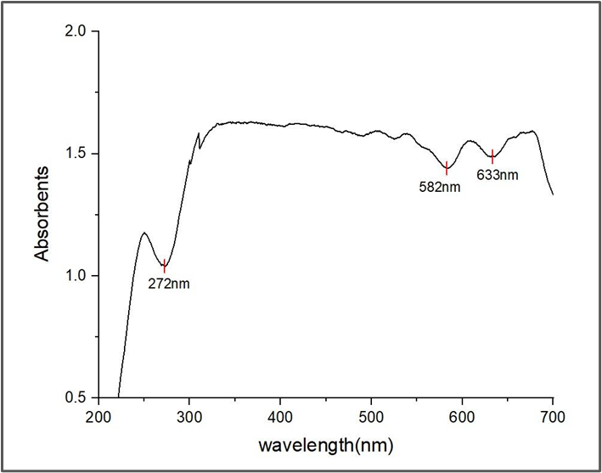
RESULTS
A.Gas chromatography-Mass Spectrometry
RT (min) | Compound Name | Molecular Formula | Relative Area (%) | Notes
9.78 | Tetradecane | C₁₄H₃₀ | 34.61 | Hydrocarbon
11.06 | α-Ionene | C₁₀H₁₆ | 0.46 | Terpene
13.69 | Myristic acid (C14:0) | C₁₄H₂₈O₂ | 1.20 | Saturated FA
13.84 | Pentadecane | C₁₅H₃₂ | 3.20 | Hydrocarbon
14.36 | Hexadecane | C₁₆H₃₄ | 2.18 | Hydrocarbon
15.06 | Heptadecane | C₁₇H₃₆ | 39.70 | Hydrocarbon
15.37 | Caffeic acid (derivative) | C₉H₈O₄ | <0.10 | Phenolic compound
17.00 | Carbanilic acid (derivative) | C₇H₇NO₂ | <0.10 | Aromatic amide
17.17 | Neophytadiene | C₂₀H₃₈ | 2.05 | Diterpene
17.70 | γ-Linolenic acid (C18:3) | C₁₈H₃₀O₂ | 1.01 | PUFA from Spirulina
19.33 | Oleic acid (C18:1) | C₁₈H₃₄O₂ | 0.90 | MUFA (Mono-unsaturated FA)
19.94 | Phytol | C₂₀H₄₀O | 3.25 | Chlorophyll derivative
B. FTIR GRAPH
C.UV-Vis Spectroscopy

Slide 14
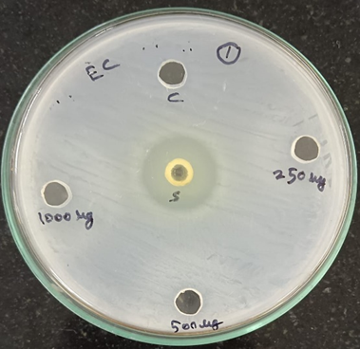
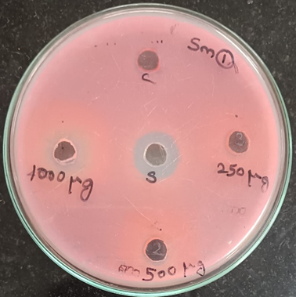
RESULTS
ZONE OF INHIBITION ASSAY
Standard -Tetracycline 25 µg
1.Escherichia coli 2.Streptococcus mutans
S. No. | Organism | STD | 1000 µg | 500 µg | 250 µg | Control
1. | Escherichia coli | 22 mm | 10 mm | 8 mm | 7 mm | 0mm
2. | Streptococcus mutans | 14 mm | 12 mm | 10 mm | 8 mm | 0 mm
The diminished growth of Escherichia coli and Streptococcus mutans around the dispensed walls in the agar medium is observed on addition of extract, proving the antimicrobial properties of Spirulina

Slide 15
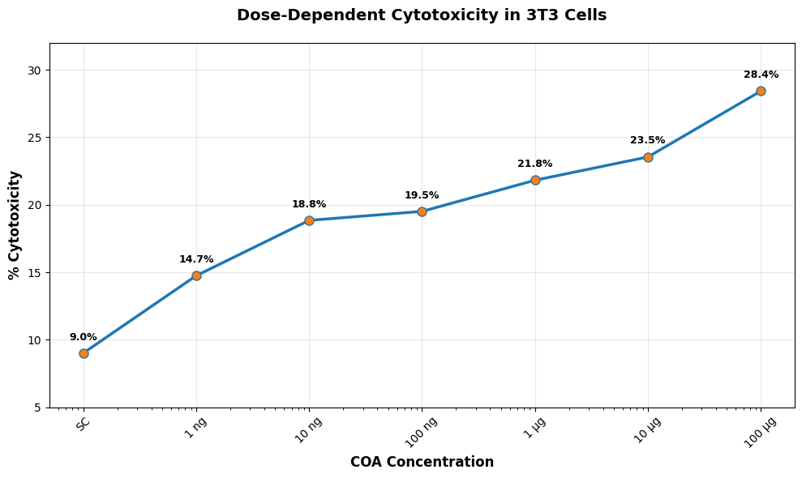





RESULTS
MTT ASSAY ON 3T3 CELLS
3T3 CELLS
CONCENTRATION
1ng
10ng
100 ng
1μg
10μg
The MTT result shows increase in % cytotoxicity with increase in concentration of Spirulina extract.This can be observed from decrease in cell count from images
100μg

Slide 16


RESULTS
(b).
(a).
[A]:The extract shows progressively stronger antioxidant activity with increasing concentration , indicating dose-responsive free radical scavenging capacity through hydrogen/electron donation thus increase in antioxidant activity of Spirulina.
[B]:With increase in concentration of extract the reducing activity increases thus proving antioxidant activity.

Slide 17

RESULTS
TOOL: ArgusLab
Nrf2 docked with Caffeic Acid
TOOL :PYMOL
Visualisation of Docked complex
Nrf2 |  | Caffeic Acid | Docking Score (Kcal/Mol) | Distance (Å) | H-Bond
AR 499 | N | O | -7.97 | 2.8 | 3
GLN 489 | NE2 | O |  | 2.59
PHE 490 | N | O |  | 2.63

Slide 18


RESULTS
TOOL: ArgusLab
Nrf2 docked with Myristic Acid
TOOL :PYMOL
Visualisation of Docked complex
Nrf2 |  | Myristic Acid | Docking Score (Kcal/Mol) | Distance (Å) | H-Bond
VAL 478 | N | O | -7.94 | 2.59 | 3
AR 502 | NH2 | O |  | 2.90
LYS 506 | NZ | O |  | 2.95

Slide 19

RESULTS
TOOL: ArgusLab
MurA docked with Carbanilic Acid
TOOL :PYMOL
Visualisation of Docked complex
MurA |  | Carbanilic Acid | Docking Score (Kcal/Mol) | Distance (Å) | H-Bond
Arg 120 | NH2 | O | -7.87 | 2.76 | 3
Lys 22 | NZ | O |  | 2.96
Asn 23 | CG | O |  | 3.00

Slide 20


RESULTS
TOOL: ArgusLab
MurA docked with Oleic Acid
TOOL :PYMOL
Visualisation of Docked complex
MurA |  | Oleic Acid | Docking Score (Kcal/Mol) | Distance (Å) | H-Bond
Asp 305 | N | O | -9.88 | 2.84 | 3
Arg 232 | NH2 | O |  | 2.99
Arg 232 | NH1 | O |  | 3.40

Slide 21
Summary:
In conclusion this study evaluates the antimicrobial and antioxidant properties of Spirulina using both in vitro and in silico methods. Antimicrobial activity was tested through zone of inhibition assays against E. coli and Streptococcus mutans, showing effective bacterial growth inhibition. Antioxidant capacity was confirmed using DPPH and Fe³⁺ reduction assays , demonstrating strong free radical scavenging activity. Cytotoxicity was assessed using the MTT assay on 3T3 fibroblast cells, revealing cytotoxicity. In silico molecular docking further supported these findings by showing strong interactions between Spirulina-derived compounds and bacterial proteins such as MurA. This proves Spirulina as a promising natural candidate for antimicrobial and antioxidant therapies.

Slide 22
Research Output:
PUBLICATION
Tile: Exploring the Antimicrobial and Antioxidant Activities of Spirulina through In Vitro and In Silico Methods
Current Status: Under correction for submission
Authors: Pavan sai.N,Sriram.B,Sherin.M,Fawaz.R.B,Dr.S.Meena kumari
Target Journal: Journal of Applied Phycology – focuses on research related to algae, including antimicrobial and antioxidant activities, and supports both In vitro and In silico methodologies.

Slide 23
REFERENCES
1.Khan, Z., Bhadouria, P., & Bisen, P. S. (2005). Nutritional and therapeutic potential of Spirulina. Current Pharmaceutical Biotechnology, 6(5), 373–379. https://doi.org/10.2174/138920105774370607
2.Miranda, M. S., Cintra, R. G., Barros, S. B. M., & Mancini-Filho, J. (1998). Antioxidant activity of the microalga Spirulina maxima. Food Chemistry, 61(4), 457–460. https://doi.org/10.1016/S0308-8146(97)00062-4
3.Sharma, N., Sharma, V., & Pandey, A. (2020). In silico docking analysis of antimicrobial peptides from Spirulina platensis targeting MurA protein. Journal of Biomolecular Structure and Dynamics, 38(10), 3023–3032. https://doi.org/10.1080/07391102.2019.1628486
4.Belay, A., Ota, Y., Miyakawa, K., & Shimamatsu, H. (2002). Current knowledge on potential health benefits of Spirulina. Journal of Medicinal Food, 5(2), 83–92. https://doi.org/10.1089/10966200260398178
5.Mishra, S. K., Shrivastav, A., & Shukla, S. (2021). Computational approach for identifying phycocyanin and phenolic derivatives from Spirulina as inhibitors of bacterial enzymes. Computational Biology and Chemistry, 90, 107386. https://doi.org/10.1016/j.compbiolchem.2020.107386
6.Gershwin, M. E., & Belay, A. (Eds.). (2007). Spirulina in human nutrition and health. CRC Press. https://doi.org/10.1201/9781420004315
7.Abdel-Daim, M. M., Abushouk, A. I., Bungău, S. G., Bin-Jumah, M., El-Kott, A. F., & Shati, A. A. (2019). In vitro and in silico evaluation of the protective role of Spirulina against oxidative and microbial stress. Environmental Science and Pollution Research, 26(3), 2879–2890. https://doi.org/10.1007/s11356-018-3749-0

Slide 24
THANK YOU

